Slide 1
Developer Training
Content Lifecycle

Slide 2
Configuring Your System

Slide 3

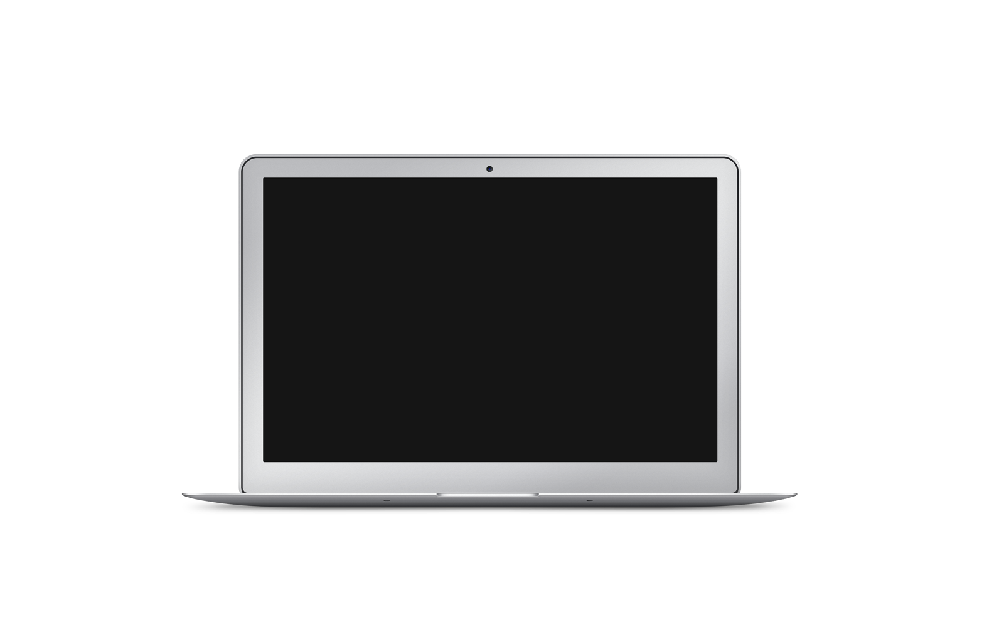
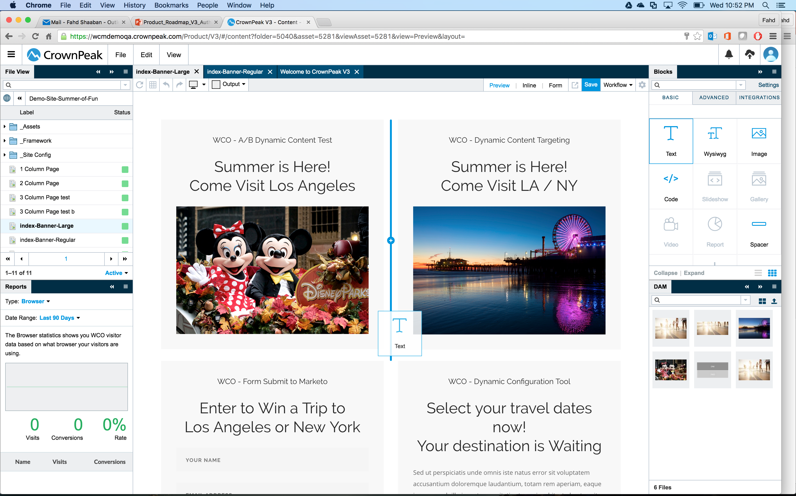
Crownpeak CMS UI – V3
https://cms.crownpeak.net/CPUK/V3/
Responsive / lightweight
Based on HTML5 & CSS3
Designed for desktop and tablet
Easy to navigate
Backwards compatible
Internet Explorer 11+
Safari
Chrome

Slide 4
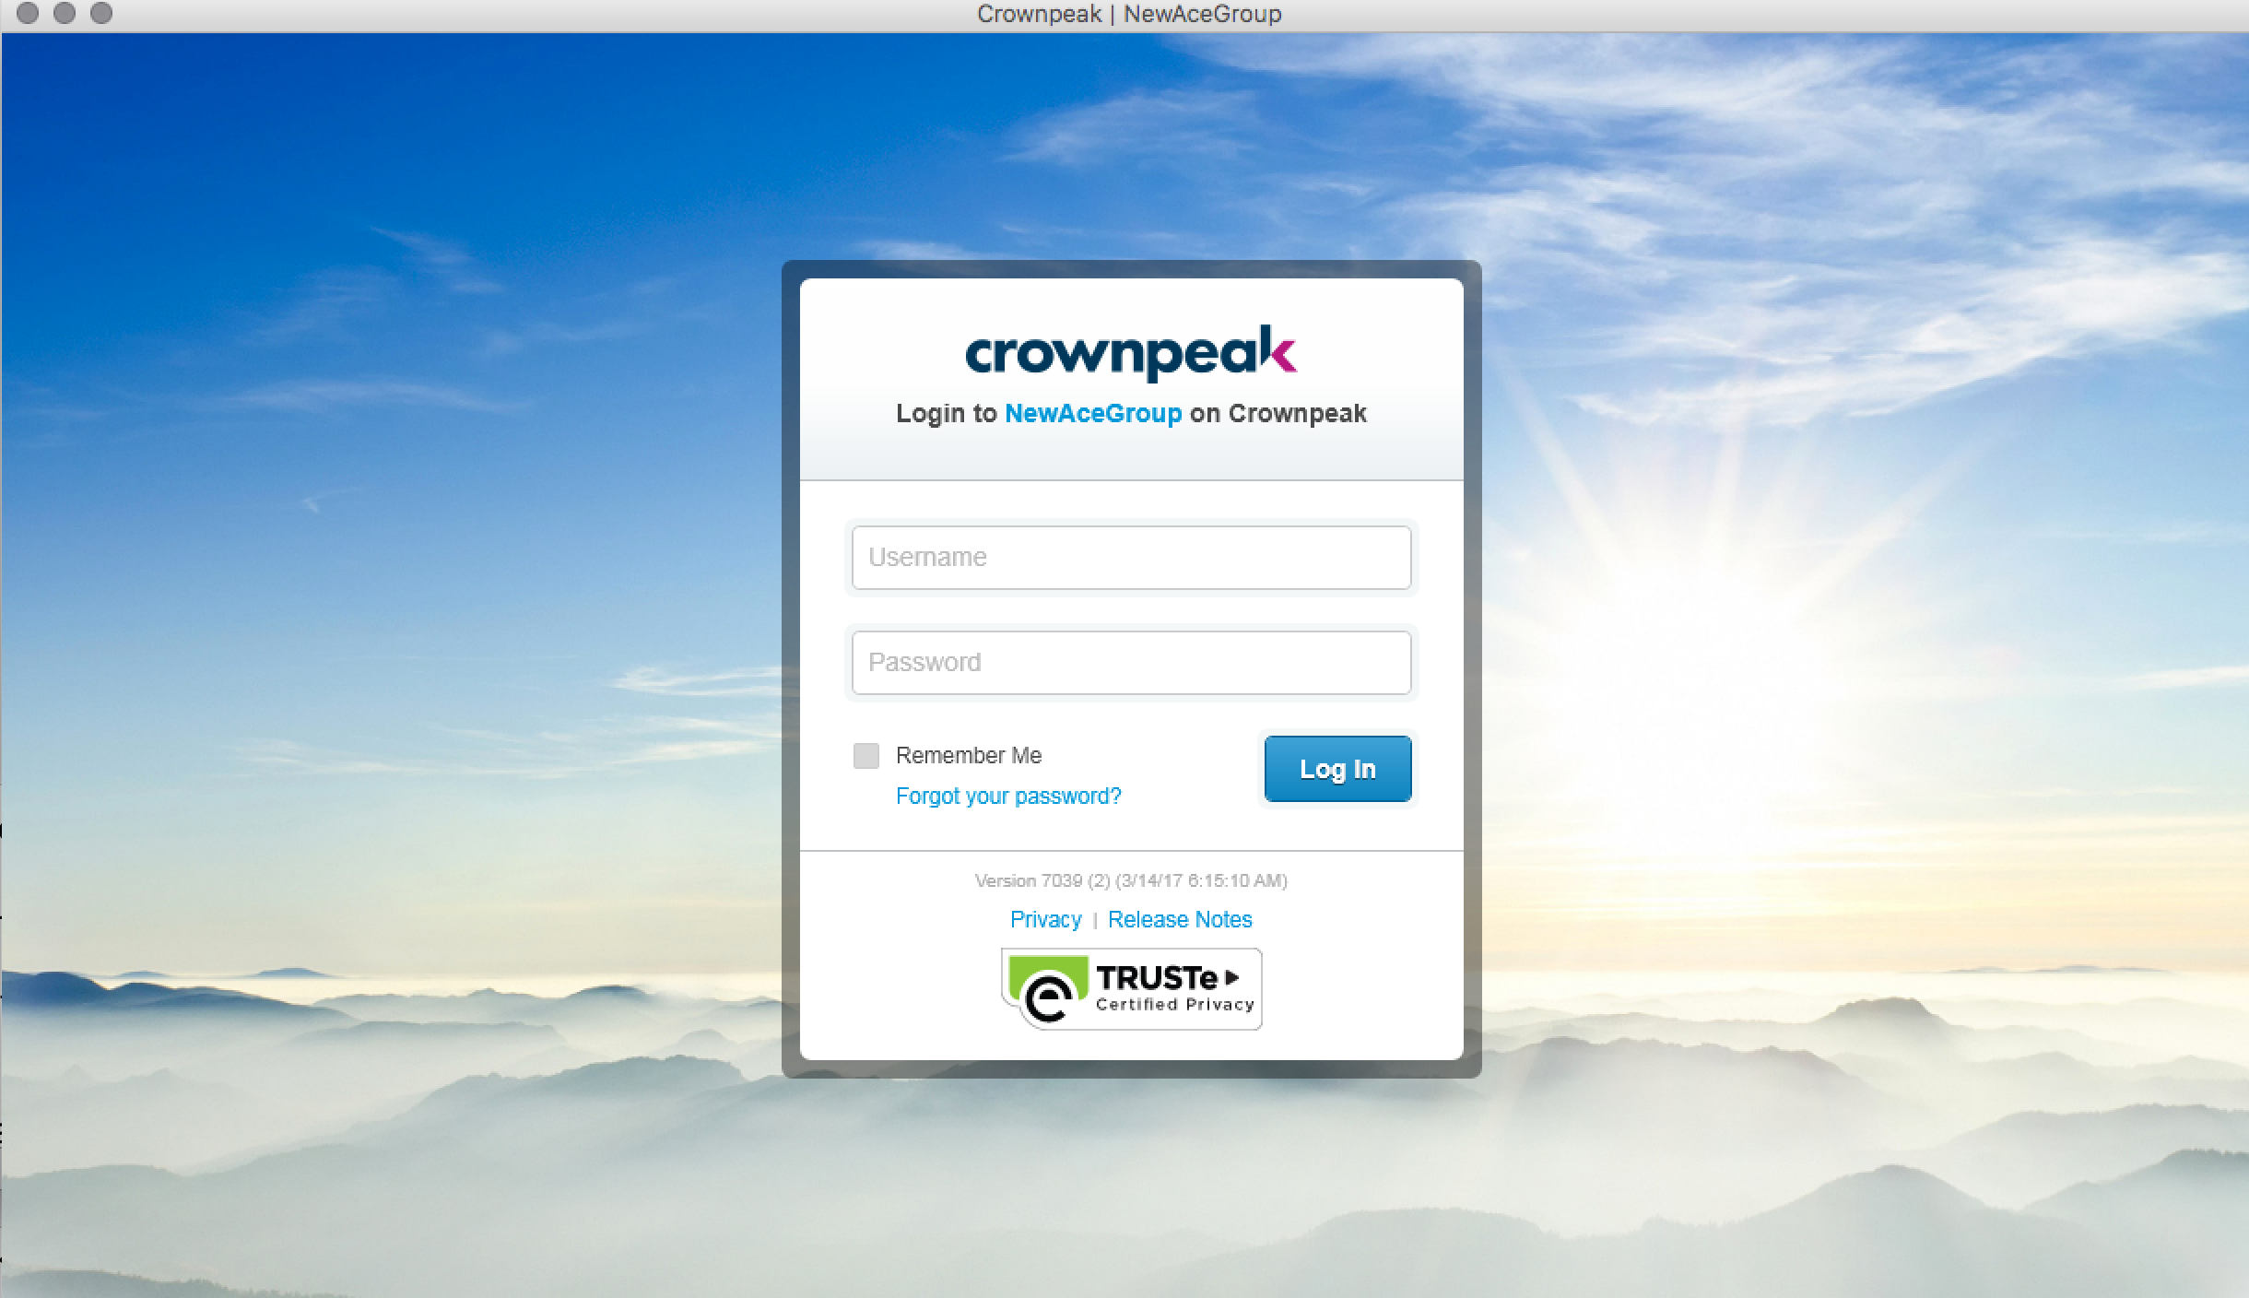
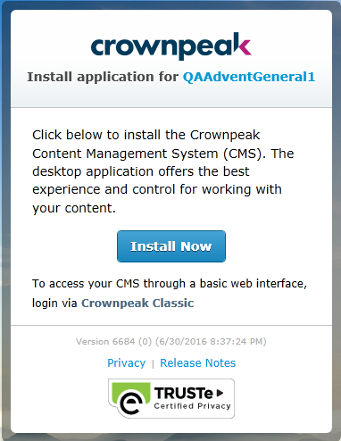
Crownpeak CMS UI – Volte (Administration)
https://cms.crownpeak.net/CPUK/UI/
Silverlight Out-of-Browser
PC:
Select Icon on Desktop or Start Menu
MAC:
Shortcut in Download Folder
Silverlight is increasingly difficult to install now that browsers are moving away from the old NSAPI component model. Use Firefox Long Term Support (LTS) to have the ability to install and enable Silverlight.

Slide 5
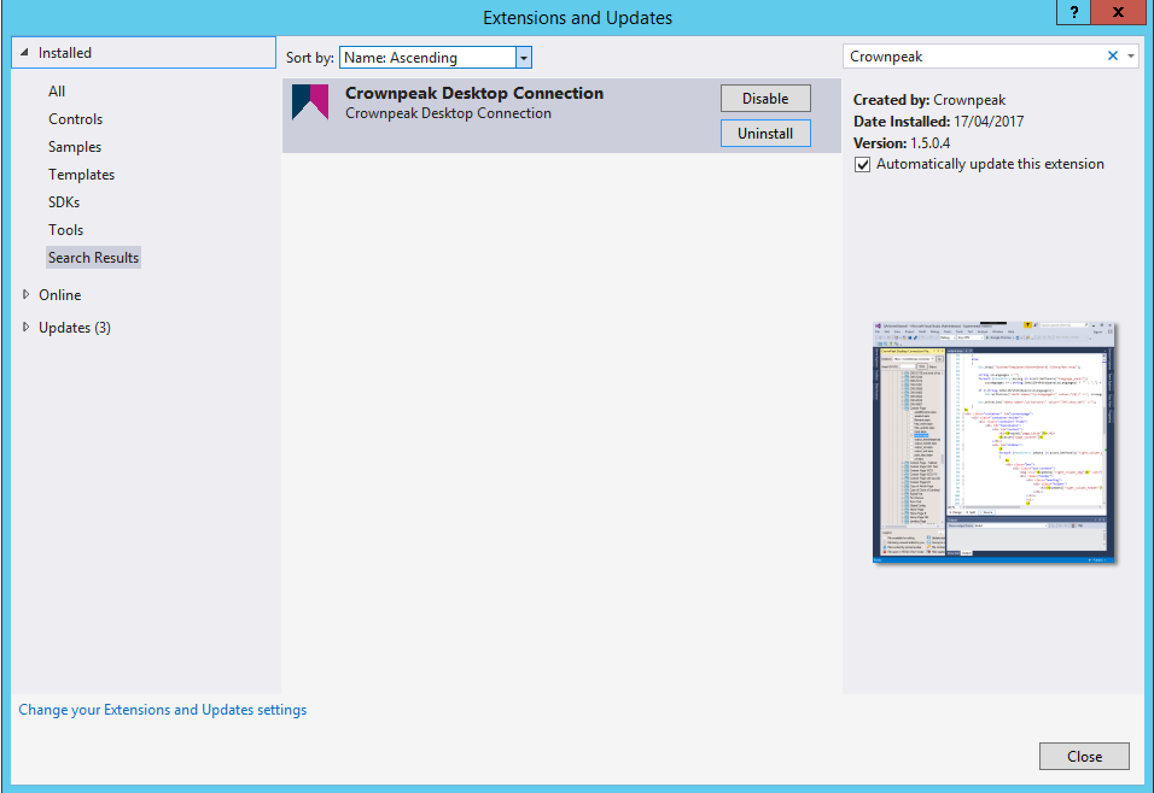
Crownpeak CMS UI – Developers: Visual Studio
http://developer.crownpeak.com/tools/vscdc/index.html
Visual Studio Integration
Support VS 2015 and VS 2017
Installed via Nuget (search for Crownpeak)
Included IntelliSense for Crownpeak CMS API
Provides direct access to Templates, Library files etc.

Slide 6
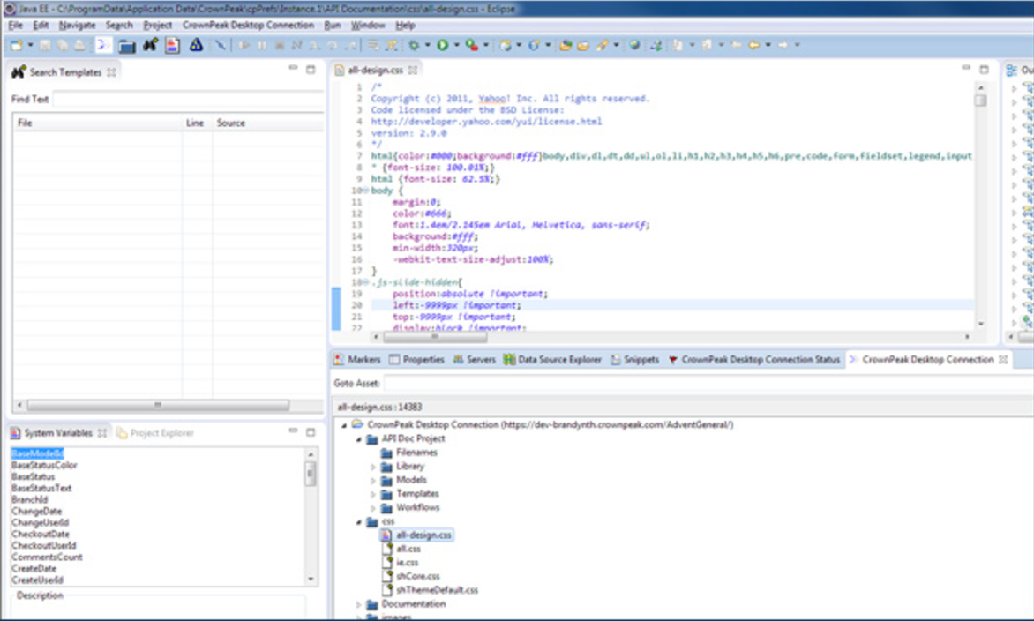
Crownpeak CMS UI – Developers: Eclipse
http://developer.crownpeak.com/tools/eclipsecdc/index.html
Visual Studio Integration
Installed via Nuget (search for Crownpeak)
Included IntelliSense for Crownpeak CMS API
Provides direct access to Templates, Library files etc.

Slide 7
Crownpeak Terminology

Slide 8
Terminology
Terminology
CrownPeak Terminology
Publishing Terminology
Developer Terminology

Slide 9
Crownpeak Terminology
Edit
Configuration, Content, or Page
Asset
Every file or folder in CMS
Each asset has an asset ID
Two types of Asset:
Templated Asset
Digital Asset
Main thing that you will do in the CMS

Slide 10
Crownpeak Terminology
Crownpeak Terminology
Templated Asset
Stored content
Digital Asset
Binary Asset – PDF, Images, JS, CSS etc
Usually stored in the /Assets/ directory
Output controlled by Templates
Can publish pages, widgets, or used for configuration

Slide 11
Crownpeak Terminology
Crownpeak Terminology
Model
Blueprint for content creation, which defines the option in New Menu
Configured by Developers – Simplifying content creation for authors
Controls template, access, and workflow for new content
Models can provide blueprints for a single page, multiple pages or an entire site structure

Slide 12
Publishing Terminology
Publishing Terminology
Draft
When you create content, you begin in the Draft state
Workflow
Defines the state and commands available to users to move content to a published environment
Not been published to any environment
Fully customizable to business requirements
Notes:
We’ll begin with Draft
When you create content, you begin in the Draft state
This content is only visible within the CrownPeak environment
Every user can modify content in draft
Note to Facilitator: There is NO SHOW for Draft
Workflow
Workflow defines the states and commands available to users to move content from creation to publishing in what we call the content life cycle.
The commands visible to you are based on the group you belong to
Workflow can only be configured by Admins and Developers
SHOW WORKFLOW
Click List View (bottom of page)
Left Click to Select page that was just created (Page File.Name.Date)
Right Click to Workflow
The first state on the list is the current state, which is Draft
You can see the other workflow options
Stage is to Deploy to a Stage Server
Dev is to send to server where developers are testing code changes
Pending is to send for approval
Choose Stage - Deploy to Stage
On the Page File you will see a small publishing icon appears indicating this is in the publishing queue
At the bottom right of the screen, you will see a publishing monitor (far left) (Can click even when spinning)
Click Publishing Monitor (looks like a stack of books)
This shows the publishing details of content being published
Click X to close
Click on Page (to select)
Right-Click and Choose Workflow
Options – Deploy to live is available now
Publish Live
You can see the status is now live is green
Transition: There are a few more publishing terms to learn

Slide 13
Publishing Terminology
Publishing Terminology
Dependency
Interconnectors between published assets in your instance
Branching
Create another instance of a piece of content or asset and have it in multiple states
Automatic & manual dependencies exist
Used when editing content to enable content authorization through workflow

Slide 14
Developer Terminology
Developer Terminology
Connector
Interface to manage 3rd party integrations and authentication information
Template
Collection of files that manage input, output, and publishing conditions for templated assets
Settings > Configuration > Connectors to add accounts

Slide 15
Developer Terminology
Developer Terminology
Site
Folder type for a site
For example: www.domainname.co.uk
Project
Folder type for templates, library, workflow and filename configuration for a site
A Project can form the basis of one or multiple Sites

Slide 16
Editing, Creating & Publishing Content

Slide 17
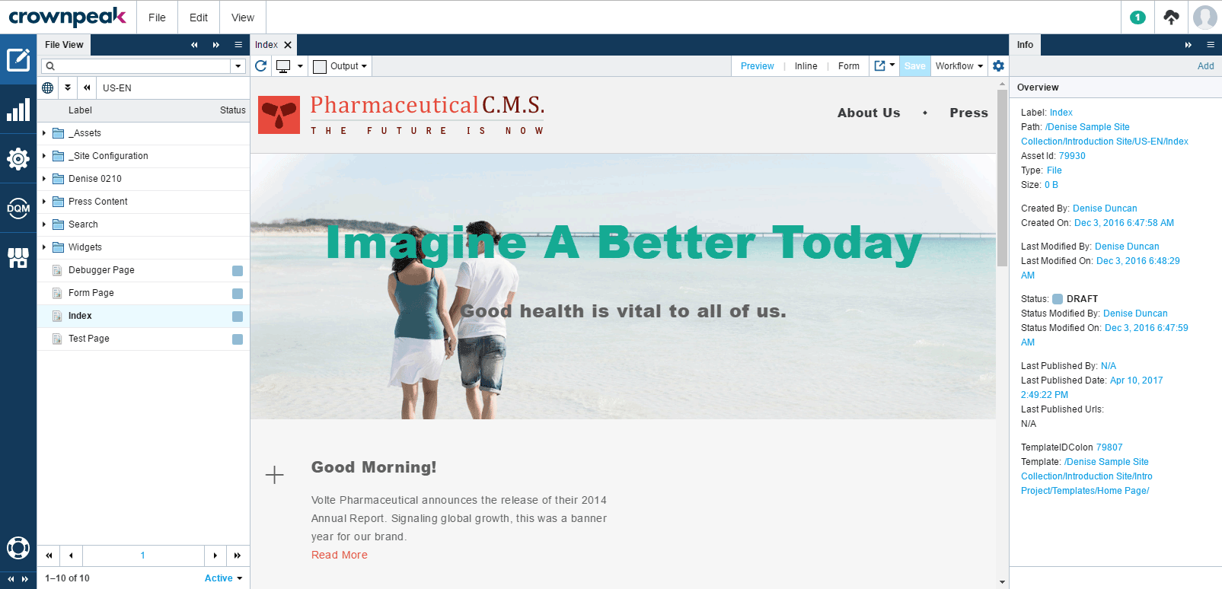
MENU
NOTIFICATIONS
CONTENT CONTROLS
BREADCRUMBS
INFO PANEL
FILE VIEW
CONTENT DETAILS
SECTIONS
Notes:
This is an overview of the CMS
I’ll explain the major areas on the page
(Click) The Menu consists of:
File Menu, which allows you to create or open content
Edit Menu, which allows users to edit, branch and access other page level commands
View Menu, which allows you to customize the display and switch the view of the current asset
(Click) Up at the top right are the Content Controls, which let you change the view of the current asset, save and use workflow
(Click) Breadcrumbs show you the path details and can be used for navigation. The drop down will also let you do a quick search of CMS content
(Click) The Info Panel is on the right, which gives users access to information about the current asset
(Click) The File View is on the left and gives access to all of the assets within your CMS
(Click) Then, on the far left are Sections buttons: content, reports, settings, DQM and applications
(Click) Finally at the very top-right, there are the Notification buttons, showing system messages, publishing and also profile
Transition: Before we begin learning more about the CMS, there is some terminology that is important for you to learn

Slide 18
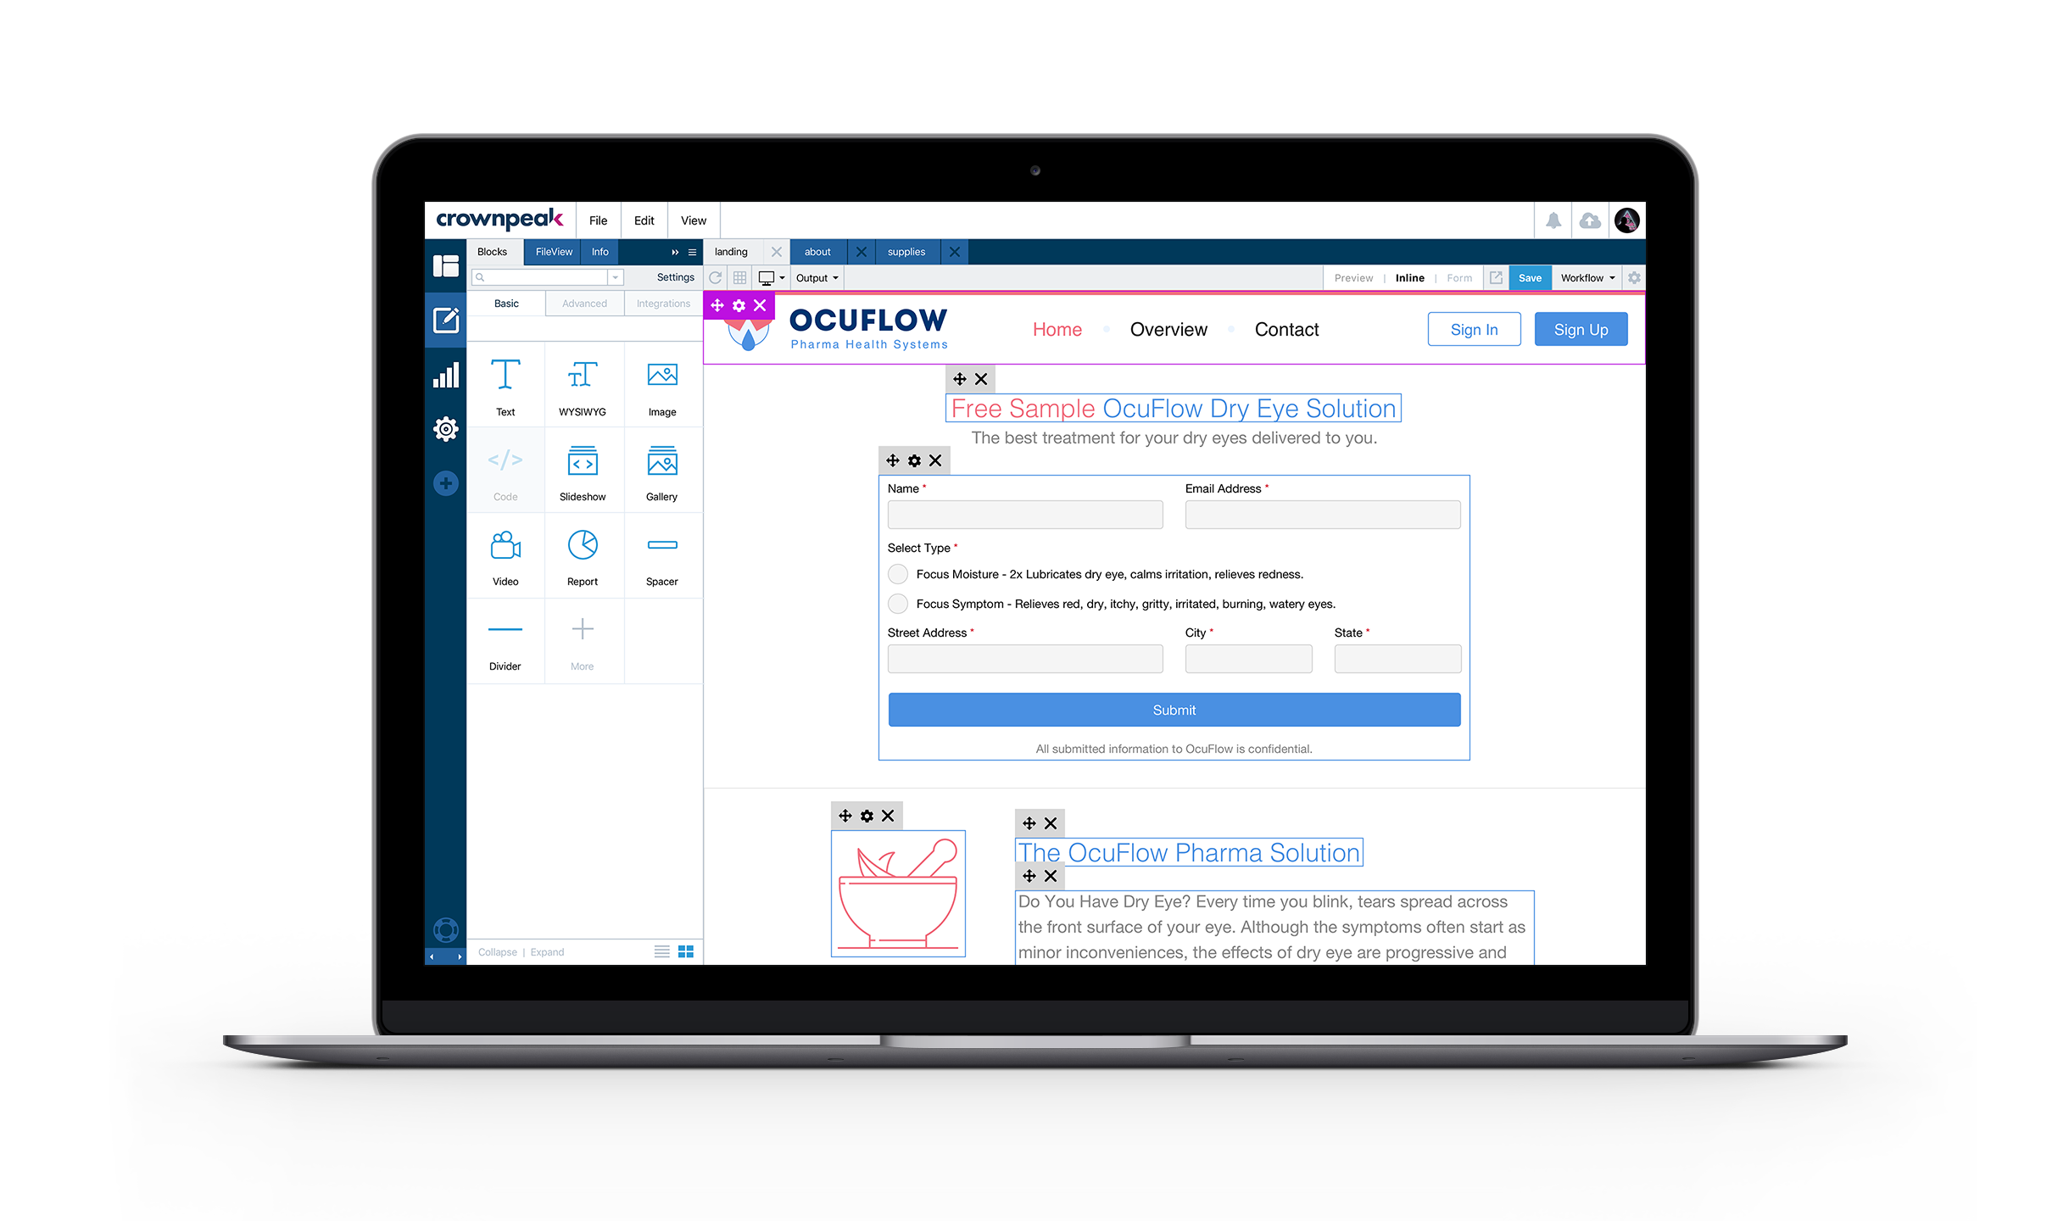
Inline Editing Mode

Slide 19
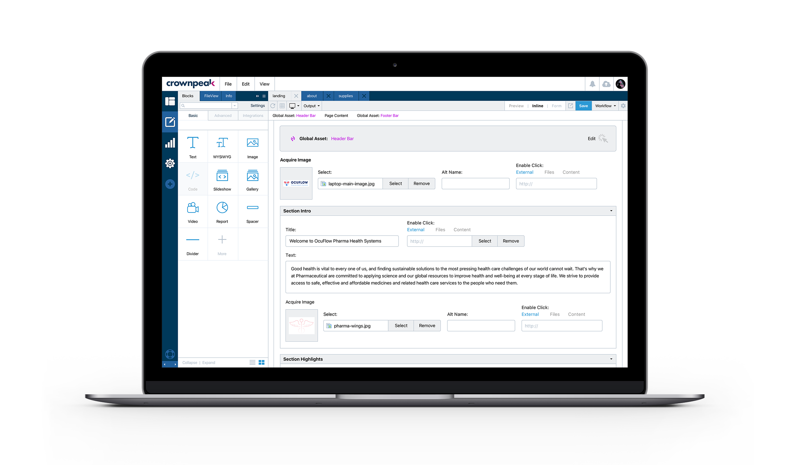
Form Editing mode

Slide 20
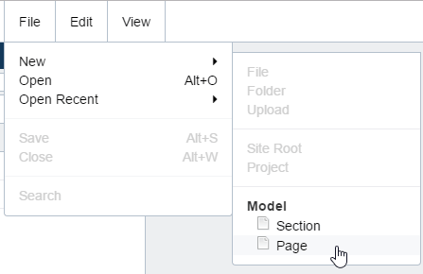
Creating New Sections & Pages - Models
Models
Accessed from the New menu
Implemented by developers or site administrators, models are used for creation of most pages and sections
Models ensure that all configuration settings will be the same
Template
Workflow
Access Properties
Can be used to create a single asset, a section, or an entire site
Ideal for
End-users, templated content, simple or complex structures, creating brand-new content

Slide 21
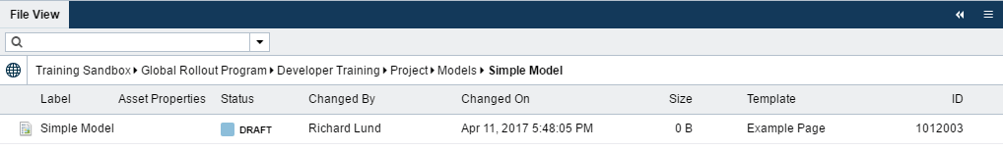
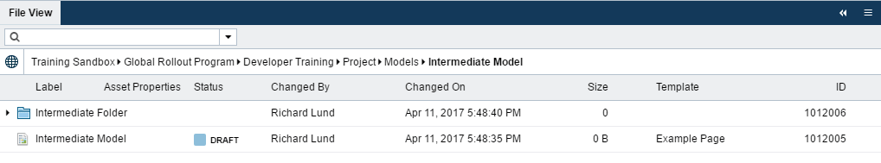
Types of Models
Simple Model
Single asset or single folder: e.g., new Article or new Press Release Year
Intermediate Model
Model with a group of assets or folders
Model with a folder pre-populated with assets
Notes:
So that is the most basic model you can create…some other common types

Slide 22
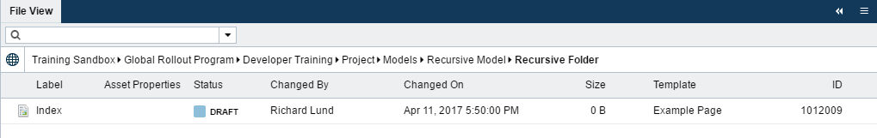
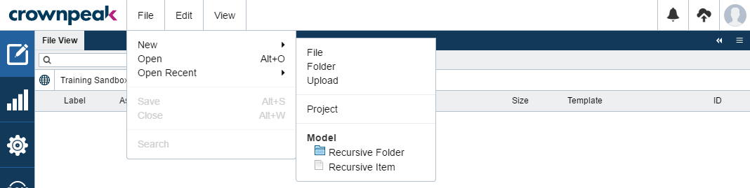
Types of Models
Recursive Model
Folder that calls itself as a model – allows for deep hierarchy of content
E.g., a Subsection folder that can create new pages or new subsections inside it to create nested subsections

Slide 23
Changing Models
Changing Models
Updating the model will not retroactively update content created by that model.
As a result, it’s important to get your Models configured properly the first time.

Slide 24
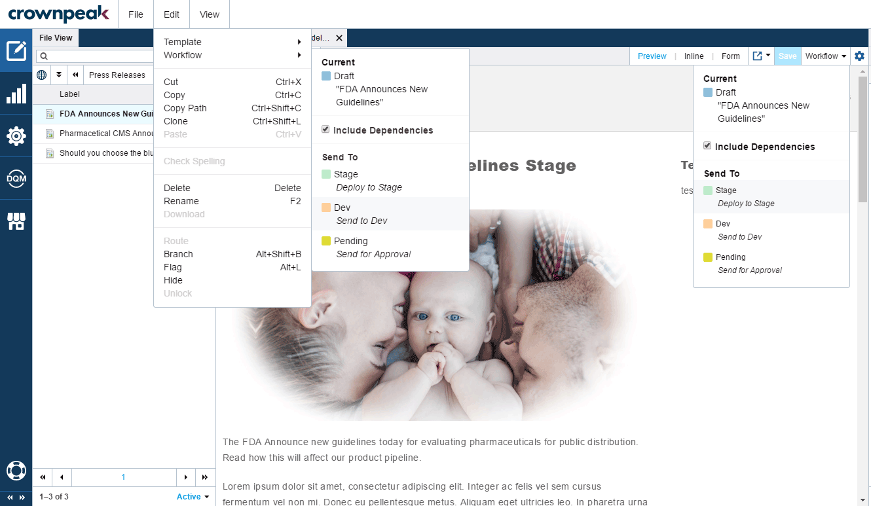
Publishing

